Slide 1
Examination Administration of the Food Safety Manager’s/Supervisor’s Course CANTRAC B-322-2101
March 01, 2023

Slide 2
REFERENCES
OPNAVINST 4061.4/MCO 4061.1, Food Safety Training Program
Tri-Service Food Code (NAVMED P-5010-1) 01March2019
https://www.med.navy.mil/Navy-Marine-Corps-Public-Health-Center/Preventive-Medicine/Program-and-Policy-Support/Food-Sanitation-and-Safety/

Slide 3
EXAMINATION ADMINISTRATION
The following mandated examination administrative requirements have been developed to help ensure:
Fairness to ALL students
Integrity in the process
Standardization
Ensure proper documentation of graduation in CeTARs
Avoid perception of favoritism
Maintain instructor integrity

Slide 4

EXAMINATION ADMINISTRATION
STAFFING REQUIREMENTS
Staffing needs will be based on the number of examinees
One Test Administrator may serve as the administrator for 25 examinees.
Additional Test Administrator may also be necessary if there are examinees with approved accommodations or some unusual room features that inhibits adequate security (too small or too large, L-shaped rooms, columns or posts obstructing the view of examinees, etc.).

Slide 5

EXAMINATION ADMINISTRATION SECURITY
Certified Instructors Responsibilities before/during Examinations
Verify identity of all examinees with photo identification.
Guide examinees instructions and procedures of taking the exam.
Supervise other Test Administrator’s assisting during the examination.
The Test Administrator(s) MUST always remain in the testing room while exam is in progress.
Safeguard the integrity of examination by following all security procedures and practices.
If an emergency occurs during the examination (fire alarm) follow all command safety requirements and have students leave tests on their table or desk.

Slide 6
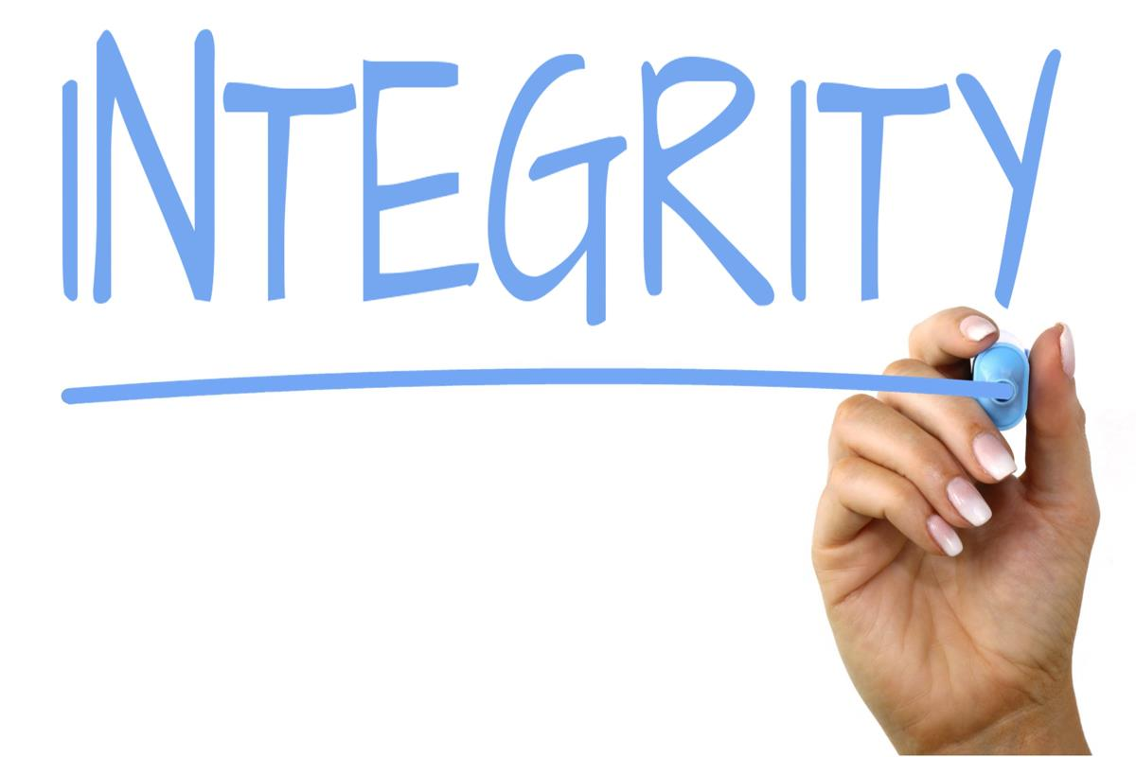
EXAMINATION ADMINISTRATION
INTEGRITY
Certified Instructors Responsibilities before/during Examinations
Provide each examinee with an equal opportunity to pass the examination by applying the general principles of fairness and nondiscrimination.
Do not answer any examination related questions.
Be aware and avoid any possible conflicts of interest.
Handle any disabled examinee special needs and unexpected circumstances.
If examinee has a problem with a question whether it is grammatical or disagrees with a question, make a note and forward to Defense Center for Public Health – Portsmouth (DCPH-P) Program Manager.
Collect completed examinations and check for proper information.

Slide 7

EXAMINATION ADMINISTRATION
ISSUES
Report any security breaches to DCPH-P.
Fill out an incident report if there were any incidents during the exam. For example, fire alarm, disruption during class, evidence of cheating, etc. Send incident to the DCPH-P.

Slide 8

EXAMINATION ADMINISTRATION
RECAP
Certified Instructors Responsibilities
Security and administration of this course must be strictly followed to ensure the integrity, credibility and student fairness of this official Navy course and to assure that students receive credit for attending and passing the course.
The certified instructor is responsible to follow the testing and certification process.
Failure to follow this process can result in student’s not receiving credit for attending and/or passing the exam.
Periodically, classes may be independently audited by DCPH-P personnel or NEMPU training experts associated with that region;
Student tests and evaluations will be monitored by DCPH-P to ensure quality training; and
DCPH-P retains the right to remove instructors from the approve instructor registry if evidence of poor instructing performance, not complying with these rules or cheating is discovered.

Slide 9
QUESTIONS
Point of Contact:
usn.hampton-roads.navmcpubhlthcenpors.list.nmcphc-foodsafetymana@mail.mil

